Slide 1

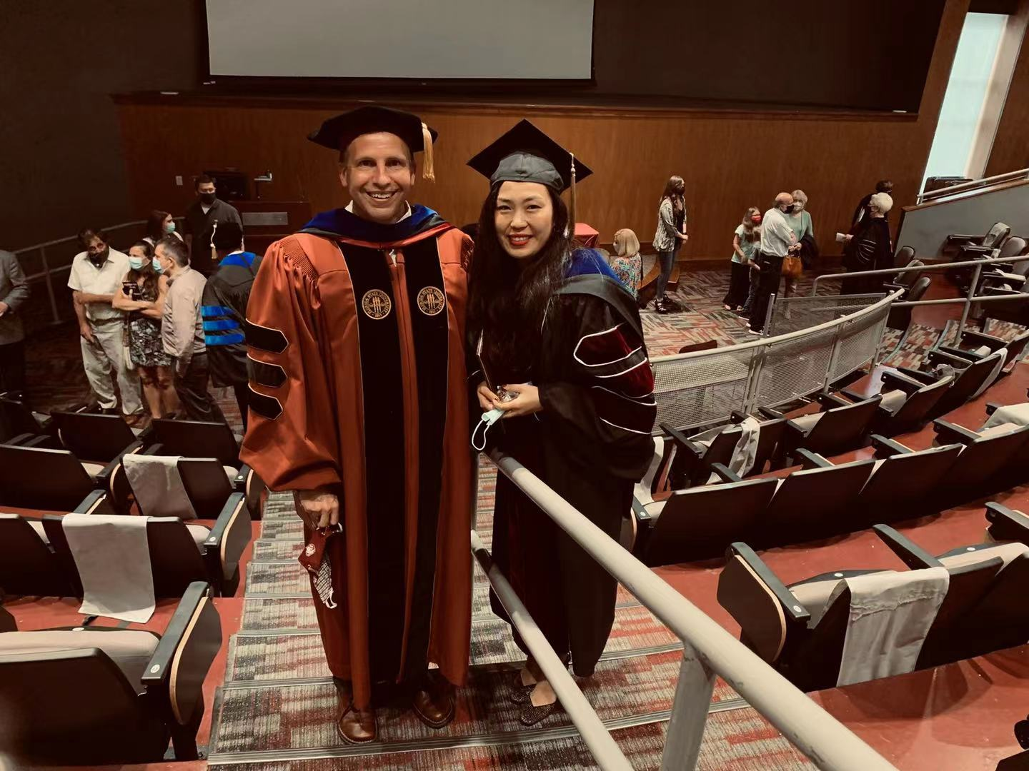

About Your Instructor
Ph.D. degree at Mississippi State University
Master degree at Middle Tennessee State University

Slide 2
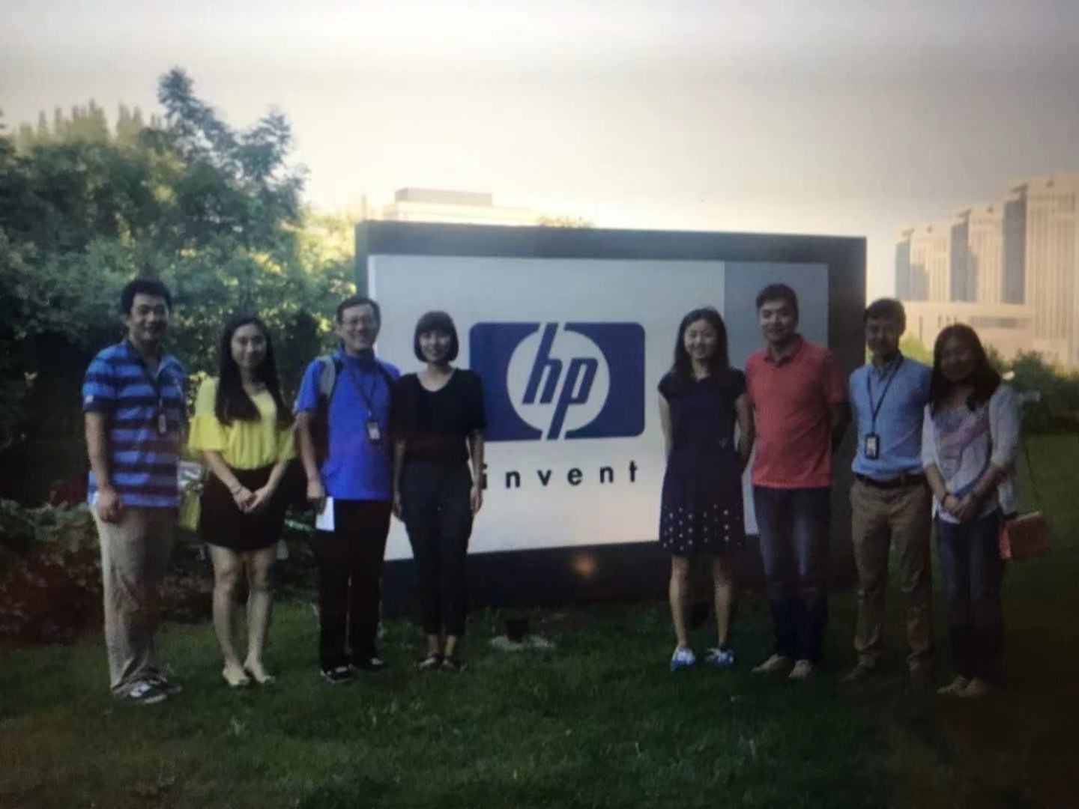



IT project manager at Hewlett-Packard company
Dalian, China

Slide 3








Slide 4

Graduate Assistant

Slide 5

Getting to Know You
Name
Where are you from
What is your major/concentration
What is one thing we would never guess about you
What have you been up to during the summer break

Slide 6

What is an Information System?
What does Management Information Systems (MIS) mean?
Business
Information Technology
MIS

Slide 7
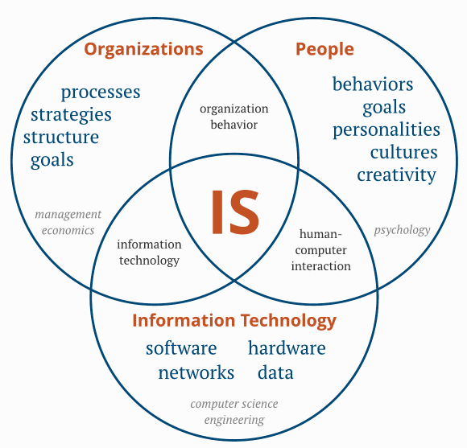
The IS discipline underlies the intersection of organizations, people, and information technology.

Slide 8
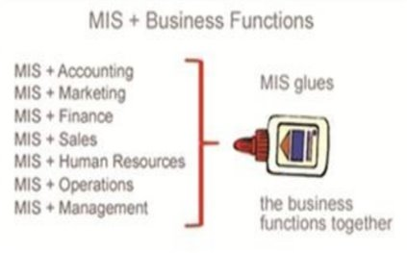



How does MIS Relate to Other Areas?
Information Technology
(Or Computer Science)
Business
So Cool – MIS!!!

Slide 9
Core Courses in the MIS Concentration
BMIS 331
Problem Solving & Programming Techniques​
BMIS 342
Data Analytics ​for Business
BMIS 441
Database Management ​
BMIS 444 Information Systems Analysis & Design​

Slide 10
Core Courses in the Business Analytics Concentration
BMIS 331
Problem Solving & Programming Techniques​
BMIS 342
Data Analytics ​for Business
BMIS 441
Database Management ​
BMIS 445/BUSN 445 Analytics Practicum
ECON 355
Regression Analysis

Slide 11

What can you do with an MIS degree/Concentration?
Be one of these:
Business Analyst
Data Analyst
Consultant
Project Manager
Web/mobile Developer
Database Administer
…so many more…
At one of these:
Amazon
Google
Apple
Facebook
Adobe
Microsoft
IBM
Pepsi Co.
…so many more…

Slide 12
MIS Base Salary
Here!
BS in MIS: $65,000
MS in MIS: $80,000
PhD in MIS: $120,000

Slide 13
Requires minimum of five years work experience after bachelors

Slide 14
What do we study in BMIS 235?
Fundamental concepts (e.g., system development cycle)
Database – SQL language and querying
Data analytics & visualization through using an intuitive tool and programming language
Web development – HTML & CSS
Tools you would learn: data.world, Tableau, Python, and Visual Studio Code

Slide 15
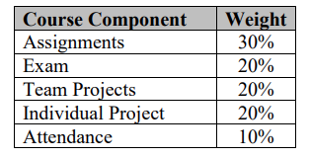
How to learn and assess your performance?
Lectures – instructor as a facilitator
Dynamic assignments
1 exam
3 in-class team projects, including SQL, Tableau, and Python
1 individual project to develop any website and present to class
Attendance

Slide 16

What would you achieve after this class?
Knowing better about MIS world?
Learned some core technologies and tools?
Gained some skills on using software...?

Slide 17

Ready for exploring the syllabus?

